Slide 1
Weekly Capstone Update
Hongyu Dai
1.31

Slide 2

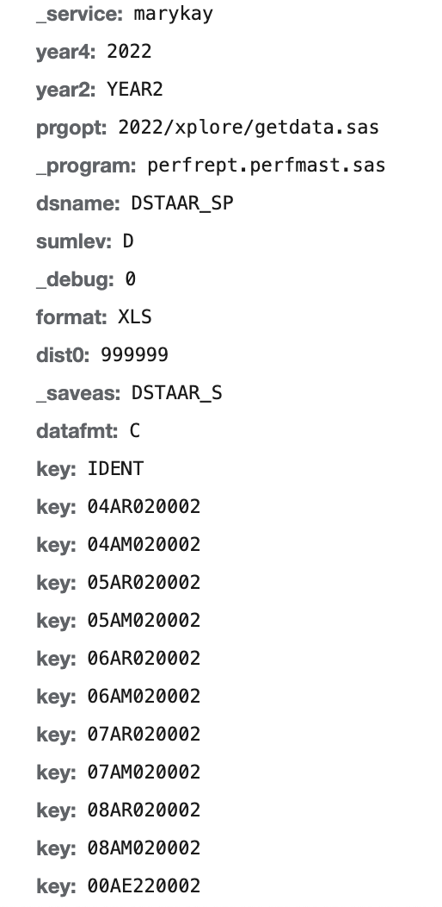

Current progress
Web scarping for ‘District Download’
The website are using ajax framework
When I click to next page, the url don’t change -> hard to fetch
Solution: using request.post with its form data parameter
Post: Form Data

Slide 3
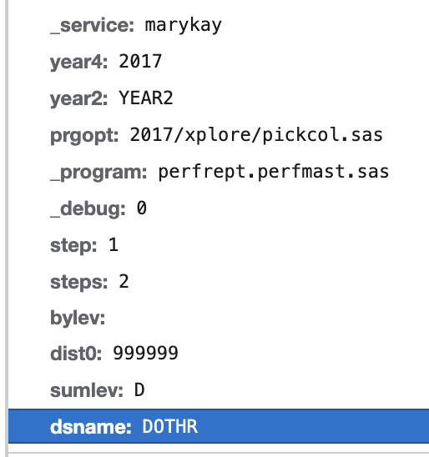
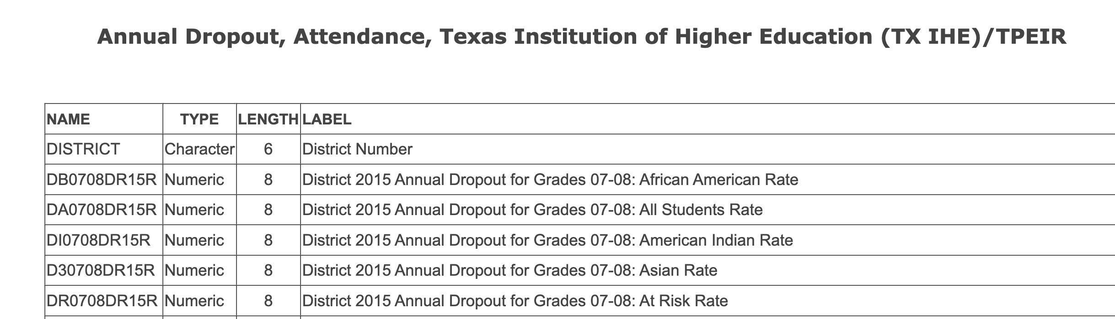
Current progress
Problem: can’t get ‘select all‘ data element by code
Solution (still working on):
using reference page to fetch all data elements fit our select metric
All data element related to this metric
Set(x[2:-3]+year_suffix)
select metric: DOTHR

Slide 4
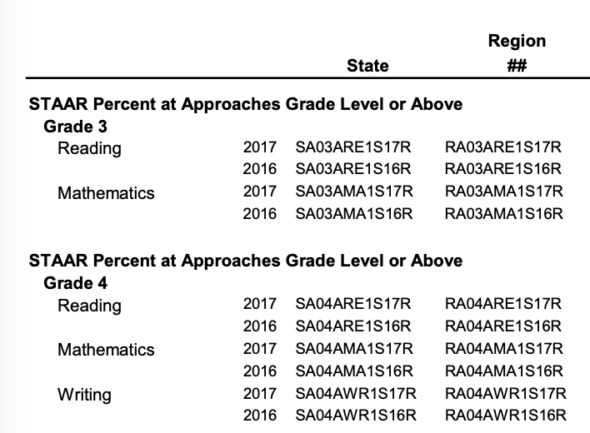
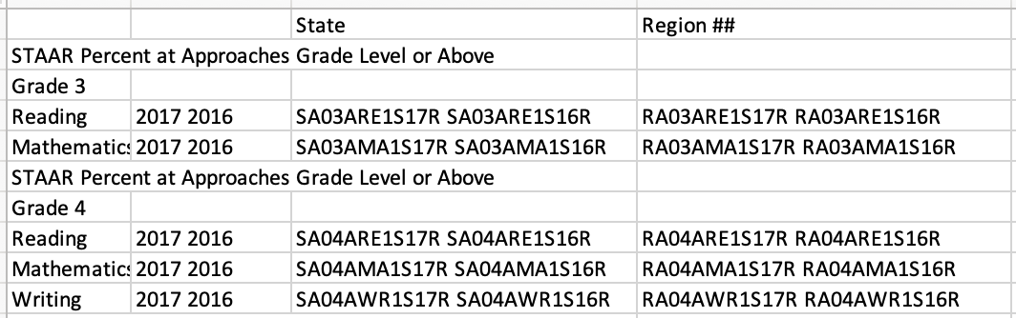
Current progress
Turn datadict+year from pdf to dataframe/csv via Azure form recognizer API
Mostly correct
Part of the content identifies 2 columns into 1 column, or 2 rows into 1 row
By Azure
Datadict_2017.pdf

Slide 5
Next steps
Things will finish within this week
Finish web scarping
Finish table mapping
by search & table QA model
Add Everyone to GitHub repo hydai99/Capstone-AllianceBernstein (github.com)

